Slide 1
ARTIFICIAL INTELLIGENCE(CS53)
ACTIVITY – PROJECT WORK
Sem/Sec: 5 ‘B’
22/12/2021
Title : Detecting Fake Movie Reviews Through Sentimental Analysis Using SVM and KNN
Ramaiah Institute of Technology
Department of Computer Science and Engineering
Team members: Hrithik B Muttin (1MS19CS051)
Sundeep Kumar (1MS19CS057)
Mahesh (1MS19CS066)
Manoj Kumar M (1MS19CS068)
ManojKumar G S (1MS19CS069)
DEPARTMENT OF COMPUTER SCIENCE AND ENGINEERING

Slide 2
OUTLINE
Introduction
Literature Survey
Problem Statement and Objectives
Methodology
Results
Conclusion
References
DEPARTMENT OF COMPUTER SCIENCE AND ENGINEERING

Slide 3
Introduction
Sentiment Analysis is the process of determining whether a piece of writing/text is positive, negative or neutral.
Reviews of any item/app are very now-a-days because they give the information to the user about the product , Its quality and many more things.
In today’s world people deliberately post the fake reviews in order to distract the costumer and get a lead from market competitor . Hence by the fake reviews people and mostly merchants can get in a big trouble .
In this research paper we aim to detect the reviews of different users in negative, positive and neutral using sentiment analysis . More particularly, we try to compare two machine learning algorithms namely: KNN and Support Vector Machine(SVM) for sentiment classification of reviews .
DEPARTMENT OF COMPUTER SCIENCE AND ENGINEERING

Slide 4
Literature Survey
Ref No. | Year | Title of the Paper | Methodology Used | Outcome | Issues
[1] | 2017 | Detecting Fake Reviews through Sentiment Analysis Using Machine Learning Techniques. | Using Weka tool Compared Different Sentiment Algorithms. | SVM is Considered To be best algorithm For Classifying Reviews. | Extracting emotions Inside The Opinion. Negative In a Situation Might Be Considered Positive In Another Situation.
[2] | 2017 | Detect Fake Online Reviews Using Machine Learning. | Length of the review, Average word Length Of The Reviewer , Number of Sentences , Percentage of Numerals Percentage of Capitalized Words. | Using User Behavior Data is Better than Using Text Data When It Comes to Detecting Fake Reviews | A.I. Bots Are Better Trained And Now Can Write More Human-Realistic Reviews, Which Make It Even Harder To Catch Fake Reviews
[3] | 2020 | Survey on Fake Online Review Using Machine Learning Algorithms. | experimental methodology. Here the data set has been considered for compression and security purpose. | Random Forest algorithm is much better when compared with several primitive algorithms | Due to the ensemble of decision trees, it also suffers interpretability and fails to determine the significance of each variable.
[4] | 2021 | Fake Reviews Detection using Supervised Machine Learning. | KNN,SVM, Logistic Regression , Random Forest , Naive Bayes | Logistic Regression Gives Highest Accuracy of 87.87% . SVM , Random Forest Have Close Accuracy Of 87.82% | Behavioral Features Are Also Very Important And Cannot Be Ignored As They Have a High Impact On The Performance Of The Fake Review Detection Process.
DEPARTMENT OF COMPUTER SCIENCE AND ENGINEERING

Slide 5
Problem Statement and Objectives
Problem Statement : Detecting Fake Movie Reviews Through Sentimental Analysis Using SVM and KNN.
Objectives :
classification of reviews.
detection of emotion.
labelling of textual data.
DEPARTMENT OF COMPUTER SCIENCE AND ENGINEERING

Slide 6
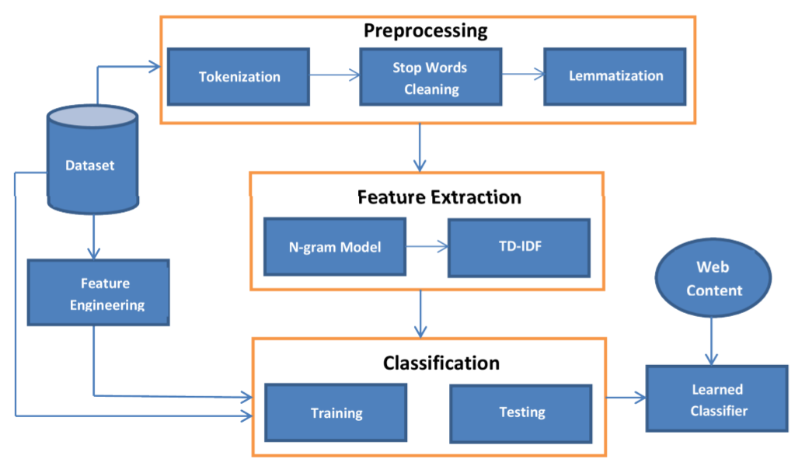
Methodology
DEPARTMENT OF COMPUTER SCIENCE AND ENGINEERING

Slide 7
Methodology
The Methodology Includes The Following Points.
Movie Review Collection.
Data Processing.
Feature Extraction.
Sentiment Classification Algorithms.
Detection Process.
Comparision of Results.
DEPARTMENT OF COMPUTER SCIENCE AND ENGINEERING

Slide 8
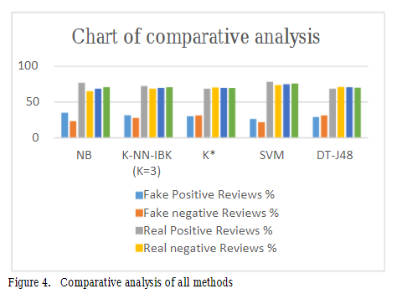
Results
DEPARTMENT OF COMPUTER SCIENCE AND ENGINEERING

Slide 9
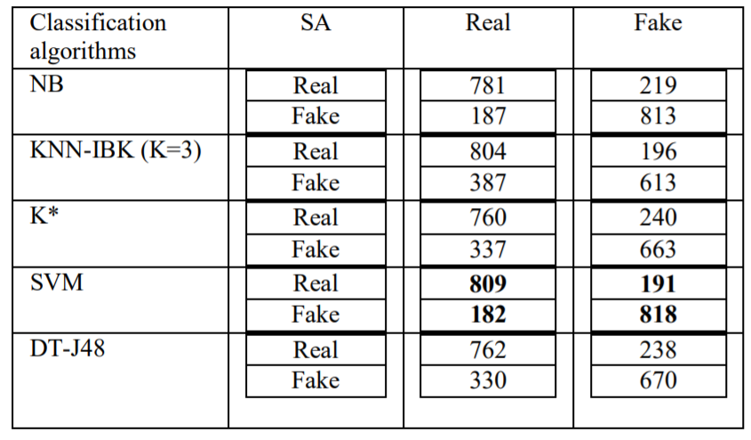
Results
Confusion Matrix
DEPARTMENT OF COMPUTER SCIENCE AND ENGINEERING

Slide 10
Conclusion
Five supervised learning algorithms to classifying sentiment of our datasets have been compared in this paper: NB, K-NN, K*, SVM, and DT-J48. Using the accuracy analysis for these five techniques, we found that SVM algorithm is the most accurate for correctly classifying the reviews in movie reviews datasets.
DEPARTMENT OF COMPUTER SCIENCE AND ENGINEERING

Slide 11
References
[1]. Ahmed M. Elmogy, Usman Tariq, Atif Ibrahim, (2021) .”Fake Reviews Detection using Supervised Machine Learning”. (IJACSA) International Journal of Advanced Computer Science and Applications ,Vol. 12, No. 1, 2021.
[2]. Elshrif Elmurngi, Abdelouahed Gherbi, (2017) .” Detecting Fake Reviews through Sentiment Analysis Using Machine Learning Techniques “. DATA ANALYTICS 2017 : The Sixth International Conference on Data Analytics.
[3]. Yuanshun Yao, Bimal Viswanath, Jenna Cryan, Haitao Zheng, and Ben Y Zhao. “Automated crowd turfing attacks and defense in online review systems”. arxiv preprint arXiv:1708.08151, 2017.
[4]. M. Hu and B. Liu, “Mining and summarizing customer reviews,” . Tenth ACM SIGKDD International Conference on Knowledge Discovery and Data Mining , pp. 168–177, Seattle, WA, USA, August 2020.
[5]. Pilkaka Anusha, Kaki Leela Prasad, (2020) . “Survey on Fake Online Review Using Machine Learning Algorithms”, Journal of Critical Reviews , ISSN- 2394-5125 Vol7 ,Issue 18 , 2020 .
DEPARTMENT OF COMPUTER SCIENCE AND ENGINEERING

Slide 12

THANK YOU
DEPARTMENT OF COMPUTER SCIENCE AND ENGINEERING

